Slide 1
Integrating Security Systems into the Final Project
Zachary Harrison, Armando Perez, Gizelle Samuels, Charles Taggart
The University of Arizona Global Campus
INT 499: Information Technology Capstone Project
Professor Miguel Kanto
03 March 2025
Notes:
Hello, the names of our group members are Zachary Harrison, Armando Perez, Gizelle Samuels, and Charles Taggart, and today I'll be presenting on the integration of security systems for our final project. This presentation will cover our project plan, software requirements, timeline, database integration, and more.

Slide 2
Overview of presentation
Introduction
SRS
Gantt Chart
Wireframes
Time Estimates
Database Integration
Conclusion
Notes:
In this presentation, we will provide an overview of our project plan. We will cover the following sections: Project Introduction, Software Requirements Specification (SRS), Gantt Chart, Wireframes, System Development Timeline, Database Integration, and Security Considerations. We’ll also discuss our coding implementation and share our GitHub repositories.

Slide 3
Project introduction
EZTechMovie is a technology-driven company specializing in media and entertainment solutions. The company aims to expand the StreamList application from an individual movie list tracker into a monthly subscription-based streaming aggregator. We are excited to implement your idea of a web application that allows people to create and manage their unique cloud-based streaming lists containing movies or programs they want to watch. We will create for you a React-based web application that will function as a go-to directory for movie and tv enthusiast.
Notes:
This project aims to integrate a robust security system into an existing application. The goal is to ensure user data is secure through authentication, encryption, and session management while providing a seamless user experience. We are incorporating features like secure login, encryption for sensitive data, and role-based access controls to protect both user and system information. We will also be introducing Service Mangers to the Application to assist with faster, web/mobile, and off-line processing.

Slide 4
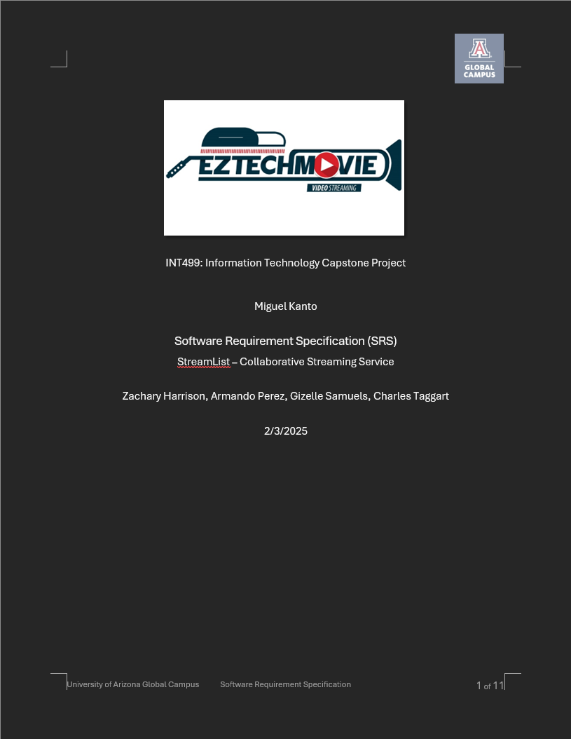
Key Software requirements specification requirements
Functional Requirements
Secure Login/Logout
Data Encryption and Security
User Interface (UI)
Search and Filter Capabilities
Error Handling and Logging
Data Management
Backup and Recovery
Notifications / Alerts
Non-Functional Requirements
Performance
Scalability
Reliability
Security
Usability
Maintainability
Compliance
Notes:
The Software Requirements Specification, or SRS, outlines the functional and non-functional requirements for the system. Functional requirements include features like user authentication, encryption, and data management. Non-functional requirements address system performance, scalability, and security standards. The SRS also defines key system interfaces, like user interactions, hardware requirements, and communication protocols
The key functional requirements for the system include:
User Authentication and Authorization: Users will securely log in, with role-based access control for varying levels of access.
Data Encryption: Sensitive data will be encrypted both during transmission and at rest.
User Interface: A user-friendly, responsive design will be implemented, ensuring usability across multiple devices.
Search and Filter: A search bar and filters will allow users to find data easily.
Error Handling and Logging: The system will capture errors and log them for troubleshooting and security purposes. These features will ensure that the system is both functional and secure for users.
Non-functional requirements focus on how the system performs and behaves under different conditions. Key non-functional requirements include:Performance: The system must handle high user traffic with a quick response time.
Scalability: It should be able to scale horizontally and vertically to meet increasing demand.
Reliability: The system should ensure high uptime and fault tolerance.
Security: We’ll follow best practices for secure data management, including encryption and regular vulnerability assessments.
Usability: The system must be intuitive and accessible to users of all technical levels.

Slide 5
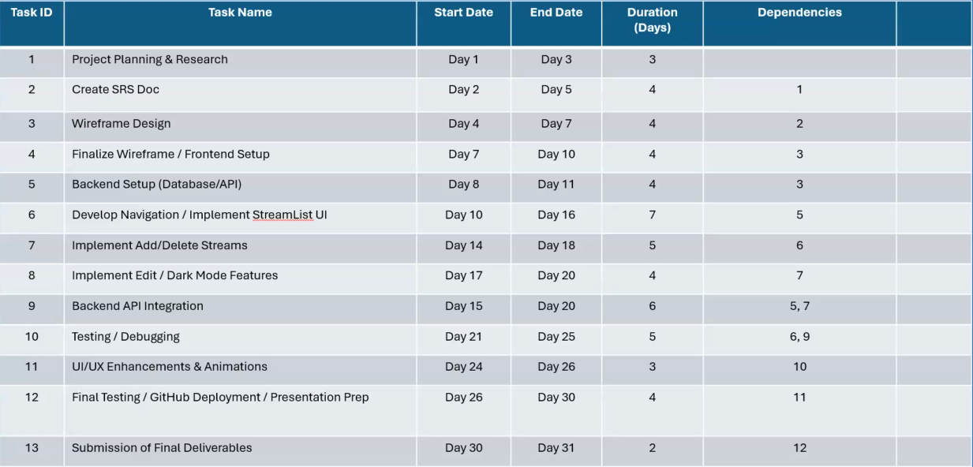
Gantt Chart
Notes:
Major tasks involved (e.g., wireframing, coding, integration, testing, etc.)
Dependencies between tasks.
Estimated durations for each task.
Milestones and deadlines.
Emphasize the time needed for developing the system from the wireframe stage.
This Gantt chart outlines the timeline for the project’s development. The project is divided into multiple phases, starting with wireframing and design, followed by coding, integration of security features, testing, and deployment. Each phase has been given a realistic duration to ensure quality and timely delivery. The tasks are interdependent, and we’ve identified key milestones, such as completing the wireframes, implementing user authentication, and running security tests

Slide 6
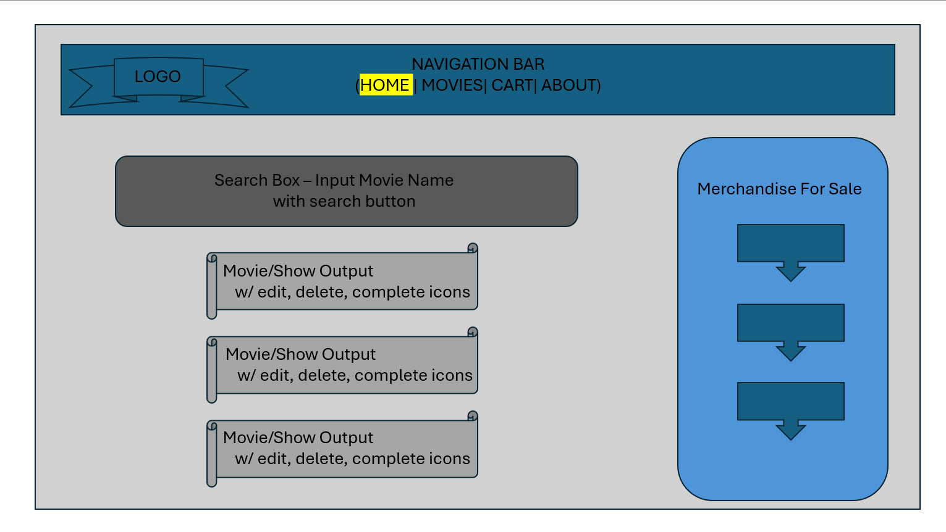
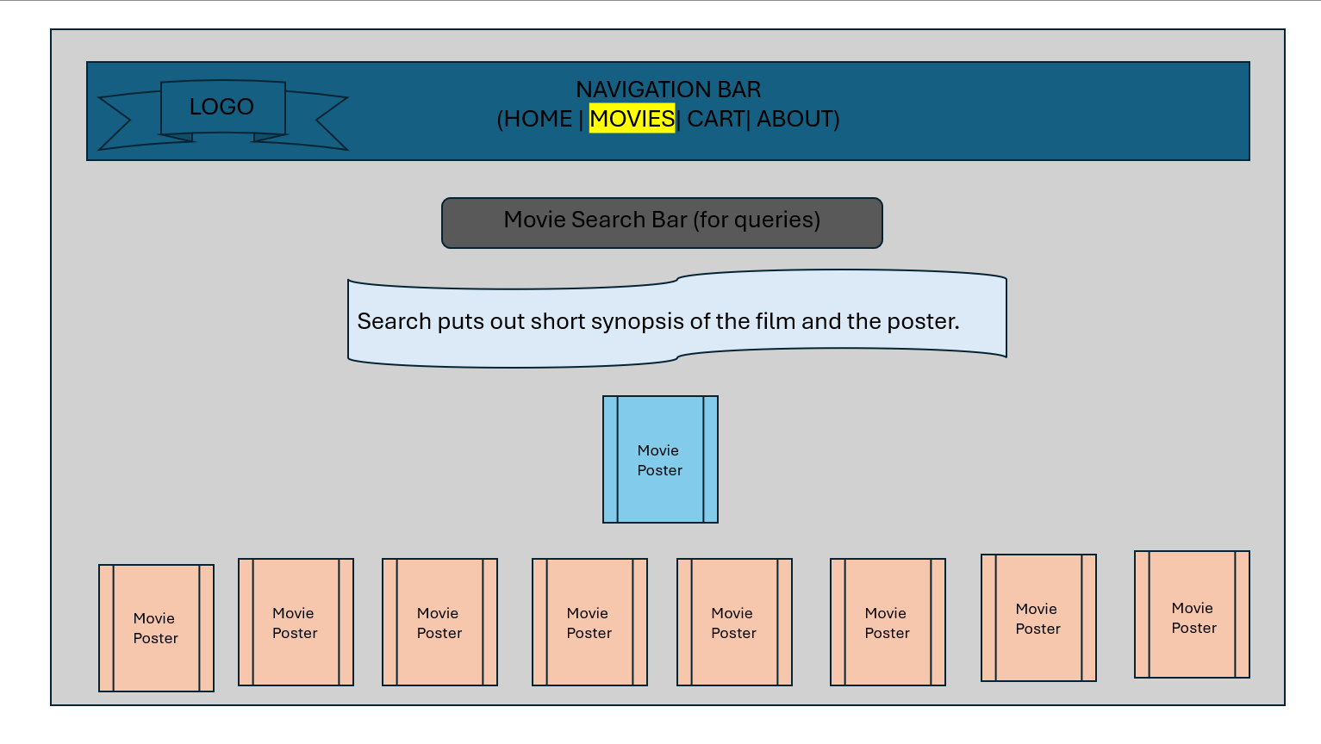
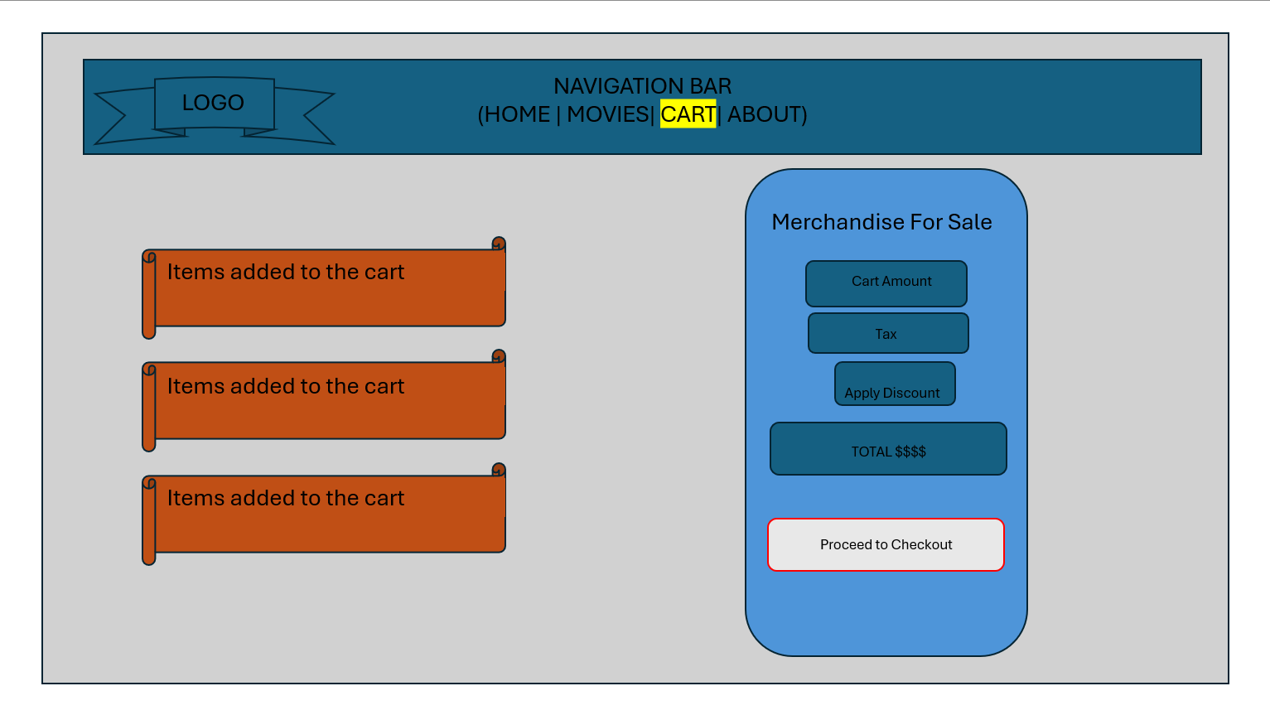
WireFrames
Notes:
Here are the wireframes of our system’s user interface. These wireframes depict the flow of the user experience, starting with the login page, followed by the main dashboard, and then navigation to the various sections, such as settings, user profile, and data management. The security features are embedded into these wireframes, including secure login forms and areas where data will be encrypted. The design is intuitive and responsive to ensure accessibility across devices.

Slide 7
Database Integration
User Management: Storing user profiles and preferences with encrypted fields for sensitive data such as passwords and personal information.
Data Persistence: Ensuring all user interactions and settings are stored in a database, providing consistency across sessions.
Secure Data Transmission: Encrypting all sensitive data in transit using TLS/SSL protocols to prevent unauthorized access during transmission.
Data Backup & Redundancy: Implementing a system for regular backups to ensure data integrity and recovery in case of failure.
We’ve opted for integrations tools such as APIs and cloud services to facilitate smooth data integration and interaction between different system components.
Notes:
For database integration, we propose using the already existing TMDB for our database of available movies and shows. In the future, should we decide to add more organic content, we will be able to use SQL/NoSQL based on the nature of our content. We would use these frameworks to ensure that we can achieve the highest levels of performance in terms of scalability, structure, or type of data. This database will store user information, security credentials, and data interactions, ensuring the integrity and security of the stored data. It will also support efficient querying and scaling as our user base grows.

Slide 8
Security considerations
Security is one of our top priorities, and we’re implementing a comprehensive strategy to safeguard user data and ensure the integrity of the system. The key security measures we are incorporating include:
Authentication and Authorization: We’ll be using [OAuth/OpenID] for secure user authentication. This system will allow users to securely log in with multi-factor authentication (MFA) as an optional feature.
Data Encryption: All sensitive data, such as user passwords and payment information, will be encrypted both during transmission (via HTTPS) and at rest using AES-256.
Session Management: User sessions will be securely managed to prevent unauthorized access or hijacking. We’ll use secure cookies and session timeouts to prevent session theft.
Regular Security Audits and Penetration Testing: Our system will undergo routine security audits to identify vulnerabilities. We will also perform penetration testing to ensure the application remains resistant to potential attacks.
Compliance with Standards: The system will comply with data protection regulations such as GDPR and CCPA, ensuring that user privacy is respected, and that data is handled ethically and legally."
8
Notes:
Here is an overview of the coding implementation, which includes modules for user authentication, data encryption, and session management. The code follows best practices, ensuring maintainability and security. We’ve used technologies like React and Node.js for the frontend and backend. You can view the complete codebase on GitHub by following our URLs listed on the final slide. Please note that we’ve excluded the node_modules folder to ensure efficient file size management.

Slide 9
Coding Implementation and Github link
The coding implementation is divided into several core components to ensure scalability, maintainability, and security. We will be using React / Node.js, for frontend and backend development, along with relevant libraries
Frontend Development: We’ll be using React to creating a dynamic and responsive user interface. Components will be modular, allowing for easy updates and maintenance, handling user input validation.
Backend Development: The backend will be developed in with RESTful APIs to handle communication between the client and server. We will implement API security by securing endpoints and using token-based authentication (JWT) for user sessions.
Authentication & Authorization: Authentication will be managed using OAuth, ensuring that only authenticated users can access the system.
Encryption & Secure Communication: All user data transmitted between the client and server will be encrypted using HTTPS (SSL/TLS) to protect against man-in-the-middle attacks. Passwords and other sensitive data stored in the database will be hashed using bcrypt, before storage to ensure that even if the database is compromised, the data remains protected.
Error Handling and Logging: We will implement robust error handling and logging throughout the system. For every failed attempt or unexpected behavior, detailed logs will be generated and stored securely for troubleshooting and monitoring potential security threats.
Notes:
Here is an overview of the coding implementation, which includes modules for user authentication, data encryption, and session management. The code follows best practices, ensuring maintainability and security. We’ve used technologies like React and Node.js for the frontend and backend. You can view the complete codebase on GitHub by following our URLs listed on the final slide. Please note that we’ve excluded the node_modules folder to ensure efficient file size management.

Slide 10
project status and next steps
Our project has made significant progress, and we are currently in the final stages of implementation. Below is a summary of our key milestones:
Wireframe & Design Completion:
The UI/UX wireframes were finalized, ensuring an intuitive and user-friendly interface.
User feedback was incorporated to refine the design.
Core Functionality Implemented:
The front-end and back-end systems have been developed using React and Node.js.
Secure authentication and authorization mechanisms (OAuth) have been integrated.
API calls are successfully fetching and displaying data from our database.
Data Integration and Security Enhancements:
The database structure has been set up, with proper indexing and encryption for sensitive information.
Secure communication via HTTPS has been implemented.
Testing & Debugging Phase:
Unit tests and integration tests are being conducted to ensure system stability.
User acceptance testing (UAT) is in progress, and initial feedback has been positive.
Overall, we are on track with our timeline, with only a few refinements remaining before the system is fully operational.
Notes:
The project is currently in the design and initial development phase. The wireframes have been completed, and we are actively working on the coding phase, focusing on implementing authentication and encryption features. The next steps involve further coding, integrating databases (as requested), conducting security tests, and preparing for deployment. Once the project is approved, we will finalize the system and begin user acceptance testing.

Slide 11

Working Demonstration – Charles Taggart

Slide 12
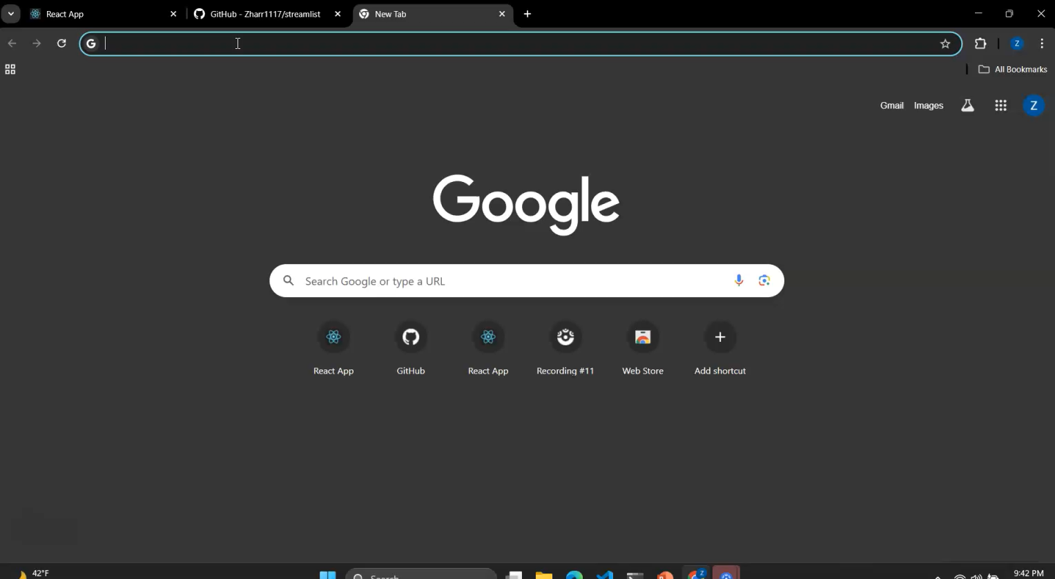
Working Demonstration – Zachary Harrison

Slide 13
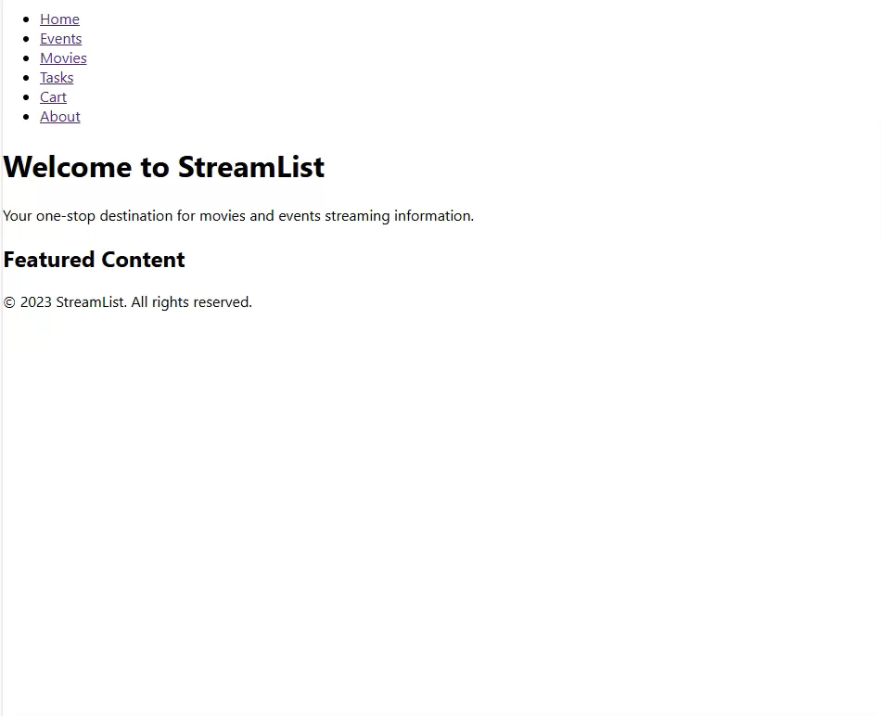
Working Demonstration – Gizelle Samuels

Slide 14
conclusion
In conclusion, integrating a robust security system into this project is paramount to ensuring the safety of user data and the integrity of our application. By implementing secure authentication, encryption, and session management, we are setting up a framework that both protects user data and complies with industry standards.
Additionally, the system’s architecture will be scalable and maintainable, ensuring long-term performance and flexibility. The careful integration of a secure database, along with regular security audits and compliance with privacy regulations, guarantees a system that users can trust.
With these features, we are confident that this project will meet the required security standards and be a success upon deployment. We look forward to receiving approval and proceeding with the next steps in development. Thank you for your attention, and we are happy to answer any questions.
Notes:
In conclusion, integrating security systems into this project is essential to ensuring user trust and compliance with data protection regulations. By implementing secure login, encryption, and role-based access control, we can create a system that provides both functionality and security. We look forward to receiving approval and moving ahead with the next steps. Thank you for your time, and we are happy to take any questions.

Slide 15

Thank you for your time and attention! We hope to work together soon!
Charles Taggart = https://chucktagg83.github.io.stream_list
Zachary Harrison = https://zharr1117.github.io/streamlist/
Gizelle Samuels =

